Slide 1
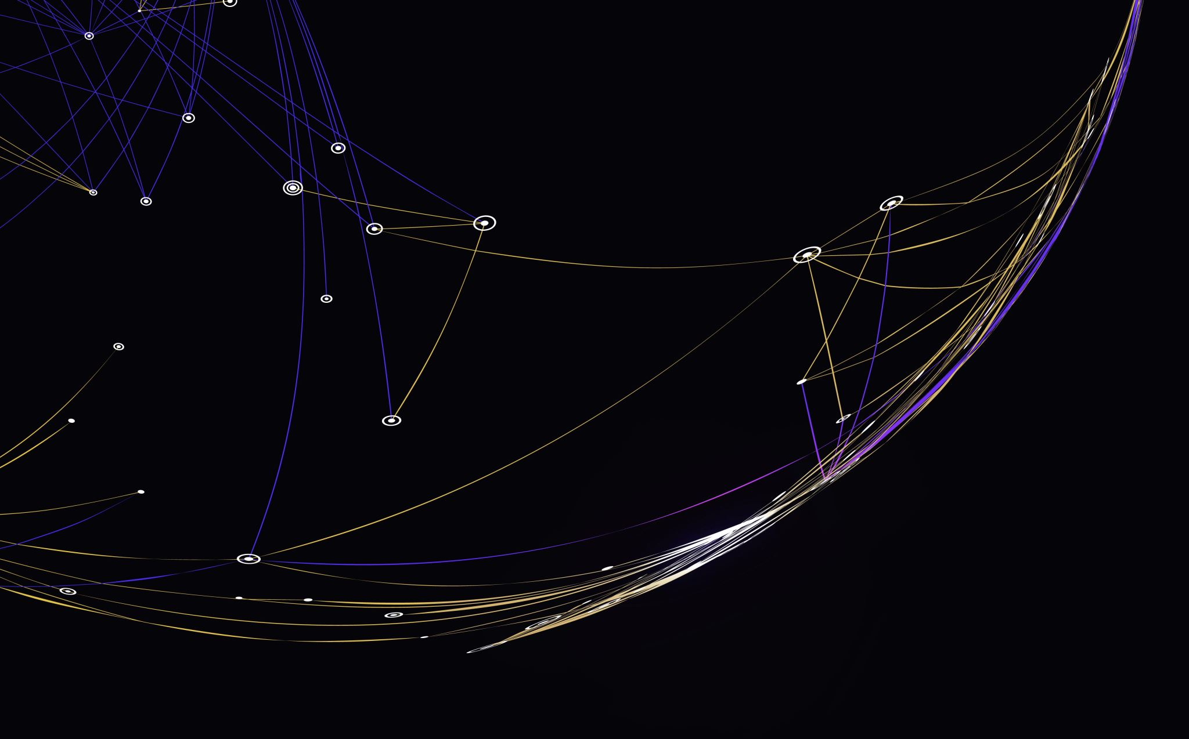
Comments
Clean Code – Chapter 4

Slide 2
Introduction
“Don’t’ comment bad code – rewrite it”.
Comments are not “pure good”.
Comments are, at best, a necessary evil.
The proper use of comments is to compensate for our failure to express ourselves through code.
Comments can’t always follow the code changes.

Slide 3
Introduction (cont.)
It’s better put the energy of writing code into making the code itself so clear and expressive that it doesn’t need the comments in the first place.
Inaccurate comments are far worse than no comments at all.
Truth can be found in one place: the code.

Slide 4
Comments Do Not Make Up for Bad Code
One of the more common motivations for writing code is bad code.
“Ooh, I’d better comment that” => No! You’d better clean it!
Clear and expressive code with few comments is far superior to cluttered and complex code with lots of comments.

Slide 5


Explain Yourself in Code
There are certainly times when code makes a poor vehicle for explanation.
Unfortunately, many programmers have taken this to mean that code is seldom, if ever, a good means for explanation.
This id patently false.
In many cases it’s simply a matter of creating a function that says the same thing as the comment you want to write.

Slide 6
Good Comments
Some comments are necessary of beneficial.
However, that the only truly good comment is the comment you found a way not to write.

Slide 7
Good Comments – Legal Comments
Copyright and authorship statements are necessary and reasonable things to put into a comment at the start of each source file.
Comments like this should not be contracts or legal tomes.
Where possible, refer to a standard license or other external document rather than putting all the terms and conditions into the comment.

Slide 8


Good Comments – Informative Comments
It’s sometimes useful to provide basic information with a comment.
For example:
But it’s better to use the name of the function to convey the information where possible => responderBeingTested.
Another example:
It might have been better, and clearer, if this code had been moved to a special class that converted the formats of dates and times.

Slide 9
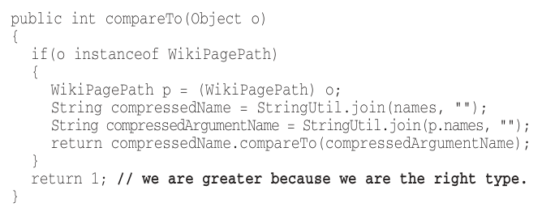
Good Comments – Explanation of Intent
Sometimes a comment goes beyond just useful information about the implementation and provides the intent behind a decision.

Slide 10
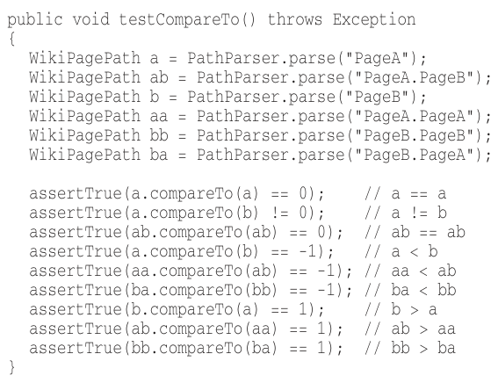
Good Comments – Clarification
Sometimes it’s just helpful to translate the meaning of some obscure argument or return value into something that’s readable.
It’s better to find a way to make that argument or return value clear in its own right.
But when it’s part of the standard library,
or in code that you can’t alter,
then a helpful clarifying comment
can be useful.

Slide 11
Good Comments – Warning of Consequences
Sometimes it’s useful to warn other programmers about certain consequences.
In the past, putting an underscore in front of the method name was a common convention.
Nowadays, we’d turn off the test case by using @Ignore attribute with an appropriate explanatory string.

Slide 12
Good Comments – TODO Comments
TODOs are jobs that the programmer thinks should be done, but for some reason can’t do at the moment.
It might be:
remainder to delete a deprecated feature or a plea for someone else to look at a problem.
a request for someone else to think of a better name.
a remainder to make a change that is dependent on a planned event.
It’s not a an excuse to leave bad code in the system.

Slide 13
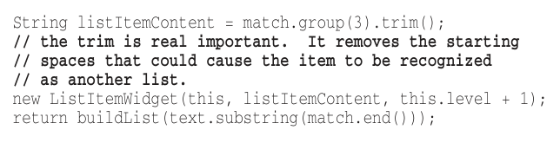
Good Comments – Amplification
A comment may be used to amplify the importance of something that may otherwise seem inconsequential.

Slide 14
Good Comments – Javadocs in Public APIs
If you are writing a public API, then you should certainly write good javadocs for it.
But javadocs can be just as misleading, nonlocal, and dishonest as nay other kind of comment.

Slide 15
Bad Comments
Most comments fall into this category “bad”.
Usually, they are crutches or excuses for poor code or justifications for insufficient decisions, amounting to little more than the programmer talking to himself.

Slide 16
Bad Comments – Mumbling
If you decide to write a comment, then spend the time necessary to make sure it’s the best comment you can write.
Any comment that forces you to look in another module for the meaning of that comment has failed to communicate to you and isn’t worth the bits it consumes.

Slide 17
Bad Comment – Redundant Comments
The comment probably takes longer to read than the code itself.
It doesn’t justify the code or provide intent or rationale.
These comments serve only to clutter and obscure the code.

Slide 18
Bad Comment – Misleading Comments
Sometimes, with all the best intentions, a programmer makes a statement in his comments that isn’t precise enough to be accurate.

Slide 19
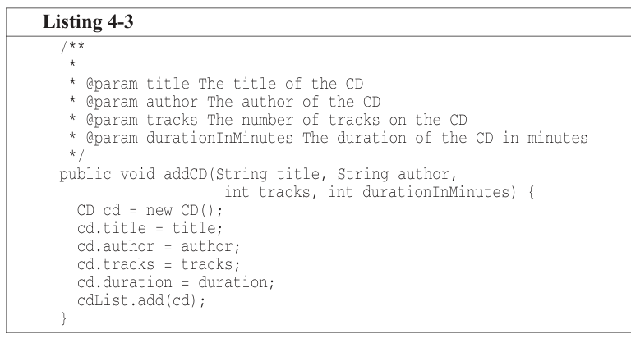
Bad Comment – Mandated Comments
It’s just plain silly to have a rule that says that every function must have a javadoc, or every variable must have a comment.
The clutter in the image
adds nothing and serves
only to obfuscate the code
and create the potential
for lies and misdirection.

Slide 20
Bad Comment – Journal Comments
Sometimes people add a comment to the start of a module every time they edit it.
These comments accumulate as a kind of journal, or log, of every change that has ever been made.

Slide 21
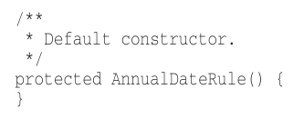
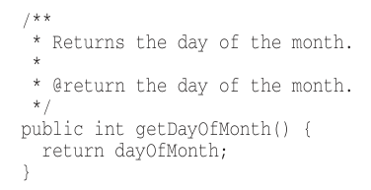

Bad Comment – Noise Comments
These comments are so noisy that we have to ignore them.
Replace the temptation to create noise with the determination to clean your code.

Slide 22
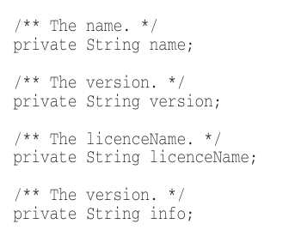
Bad Comment – Scary Noise
Javadocs can also be noisy.
They are just redundant noisy comments written out of some misplaced desire to provide documentation.

Slide 23


Bad Comment – Don’t Use a Comment When You Can Use a Function or a Variable
From:
To:

Slide 24
Bad Comment – Position Markers
Sometimes programmers like to mark a particular position in a source file.
There are rare times when it makes sense to gather certain functions together beneath a banner.
In general, they are clutter that should be eliminated – especially the noisy train of slashes at the end (in the image).
If you overuse banners, they’ll fall into the background noise and be ignored.

Slide 25
Bad Comment – Closing Brace Comments
Sometimes programmers will put special comment on closing braces, like “// while” at the end of the while loop.
This might make sense for long functions with deeply nested structure.
If you find yourself wanting to mark your closing braces, try to shorten your functions instead.

Slide 26
Bad Comment – Attributions and Bylines
“ /* Added by Rick */”.
Source code control system is a better place for this kind of information.

Slide 27
Bad Comment – Commented-Out Code
In sixties, commenting-out code was useful.
Now, we have good source code control systems, they will remember the code for us.
We don’t have to comment it out anymore.
Just delete the code.

Slide 28
Bad Comment – HTML Comments
HTML in source code comments is an abomination.
It makes the comments hard to read in the one place where they should be easy to read-the editor/IDE.
If comments are going to be extracted by some tool (like Javadocs) to appear in a Web page.
Then it should be the responsibility of that tool.
Not the programmer.

Slide 29
Bad Comment – Nonlocal Information
If you must write a comment, then make sure it describes the code it appears nearby.
Don’t offer systemwide information in the context of a local comment.

Slide 30
Bad Comment – Too Much Information
Don’t put interesting historical discussions or irrelevant descriptions of details into your comments.

Slide 31
Bad Comment – Inobvious Connection
The connection between a comment and the code it describes should be obvious.
The purpose of a comment is to explain code that doesn’t explain itself.
It’s pity when a comment needs its own explanation.

Slide 32
Bad Comment – Function Headers
Short functions don’t need much description.
A well-chosen name for a small function that does one thing is usually better than a comment header.

Slide 33
Bad Comment – Javadocs in Nonpublic Code
As useful as javadocs for public APIs, they are anathema to code that is not intended for public consumption.
Generating javadoc for the classes and functions inside a system is not generally useful, and the extra formality of the javadoc comments amounts to little more than cruft and distraction.

